Slide 1
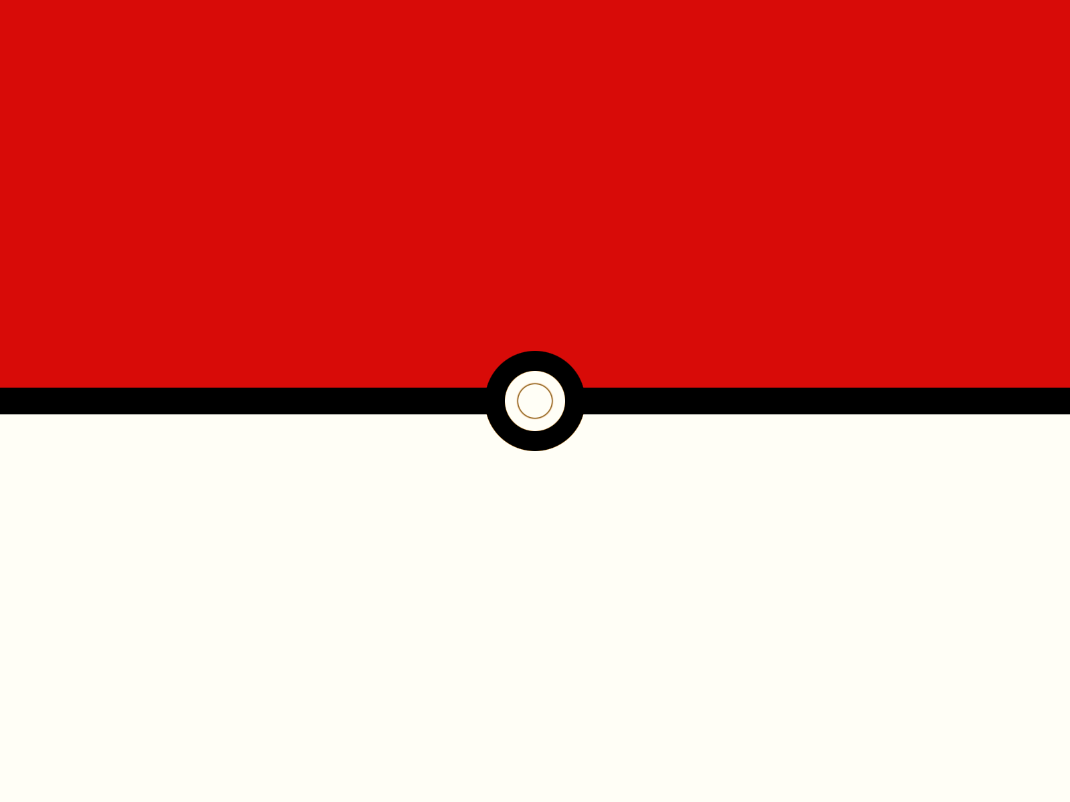
Development
of the Zygote

Slide 2
Once the male gamete (sperm, pollen) and female gamete (eggs) have fused they become a zygote
Once a zygote begins to divide and grow it is called an embryo
There are a few different ways plants and animals protect their embryos.

Slide 3
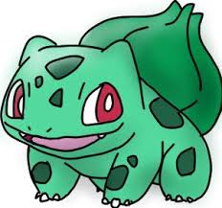
Plants
Once a plant egg has been fertilized, the embryo (known as a seed) is stored in the ovary of the plant.
The ovary turns into the fruit of the plant.
The fruit will fall, be eaten, or find some other way to disperse the seed so the seed can find a new place to go.

Slide 4
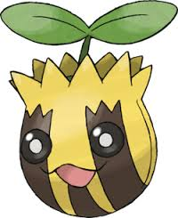
The seed
The seed has an interesting structure:
It stores not only the growing embryo of a new plant
A shell or coat to protect it from the elements
The food it needs to survive until the plant can begin photosynthesis
The stored food is in the form of starches and sugars
Most of the world’s food comes from three seeds: wheat, rice, and corn.

Slide 5
Structure of the seed
Cotyledons: the seed leaf found inside a seed
A monocotyledon (or monocot for short) is a seed with only one seed leaf (like corn or rice)
A dicotyledon (or dicot) is a seed with two seed leaves (like most beans)
Radicle: the part of the plant embryo that develops into the roots

Slide 6
Structure of the seed
Epicotyl: the part of the plant embryo that becomes the stem and leaves
Hypocotyl: the part of the plant embryo that pushes up through the soil and protects the epicotyl for bean plants

Slide 7
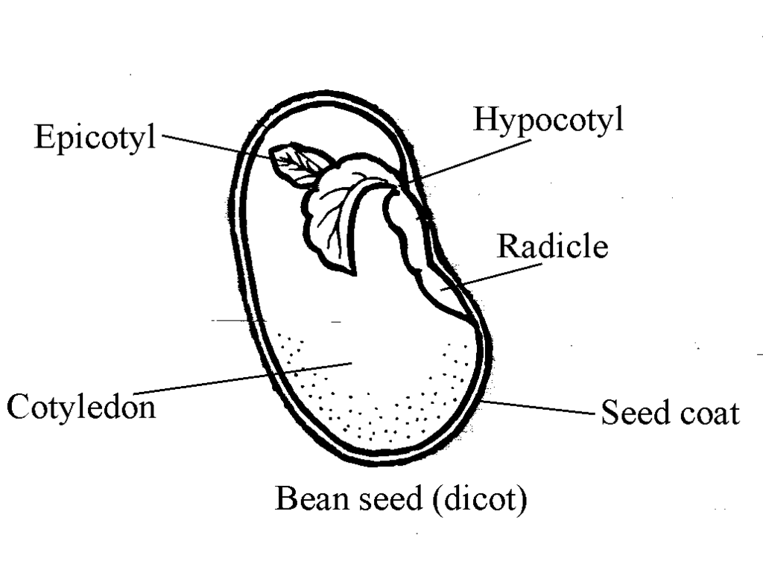
Structure of the seed

Slide 8
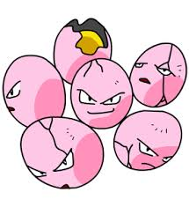
Eggs
The majority of animals lay eggs. Eggs are a structure that contain: the zygote, some nutrients, and some form of protection.

Slide 9
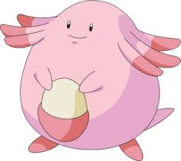
Ways to protect eggs
Some animals like turtles, or fish, try to bury their eggs to keep them safe from predators until they hatch.
Some other animals (usually aquatic) like frogs surround their eggs with a jelly, to anchor the eggs in place and provide a source of food for the newly hatched young.

Slide 10
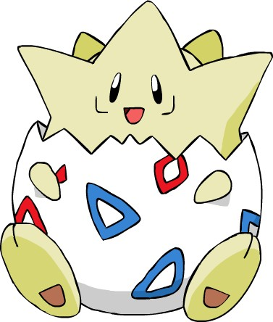
Ways to protect eggs
Other types of eggs have hard shells around them to protect them from breaking and exposing the developing embryo to danger
Some animals will abandon their eggs the moment they are laid, while others will tend to the eggs to ensure they hatch.

Slide 11
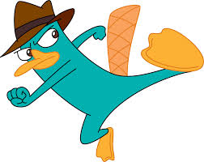
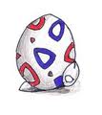
Fun Fact
Only three mammals lay eggs: two species of spiny anteaters and the platypus. They are called monotremes.

Slide 12
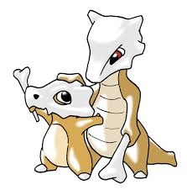
Embryo Development Inside the Mother
Every other mammal has their embryos develop inside the mother.
Embryonic development inside the mother often takes far more time than other forms of reproduction, but usually results in a living offspring

Slide 13
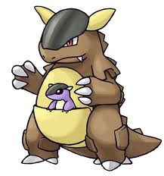
Two methods of development inside a mother
Marsupials (like kangaroos, koalas) give birth very early, and therefore, not fully developed
The baby animals will crawl from the birth canal into the mother’s pouch
There it will feed from the mother some more and grow until it is ready to leave the pouch.
Even when it leaves the pouch, the young may still retreat there to stay safe

Slide 14
Two methods of development inside a mother
Placental mammals (like cats, dogs, goats and people) develop inside the mother much longer than the embryos of marsupials.
They are connected to the mother by an organ called the placenta.
The growing embryo is called a fetus
The placenta forms between the mother and the fetus.
The fetus is attached by the umbilical cord.
The mother will, through the placenta and umbilical cord, share what she consumes with the growing embryo.
The fetus’ waste is removed by the umbilical cord into the mother for her to dispose.

