Slide 1
Traits

Slide 2
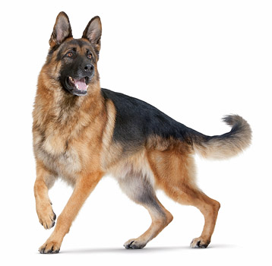
Physical Traits

Slide 3
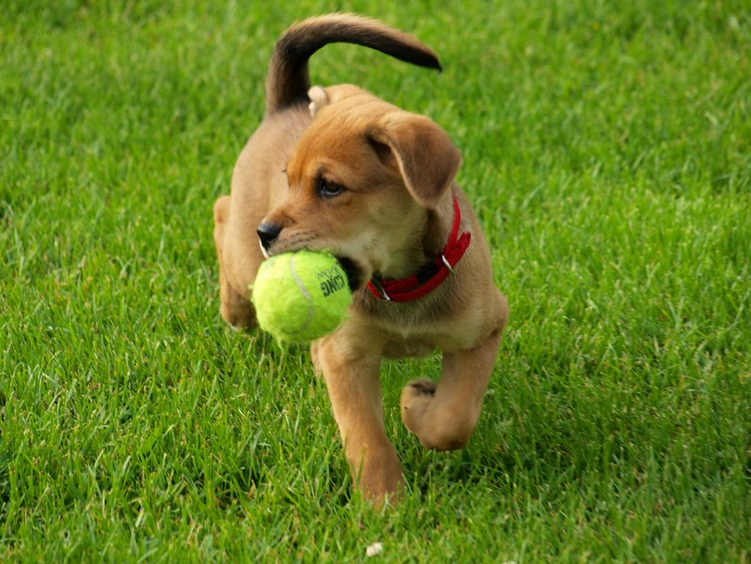
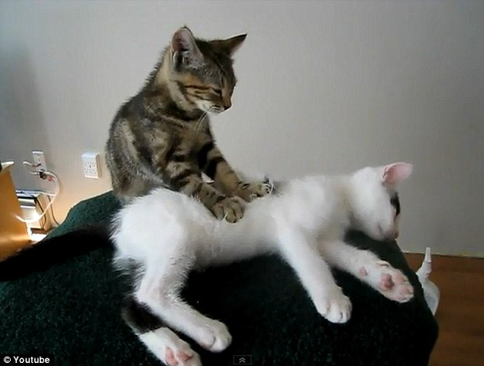
Behavioural Traits

Slide 4
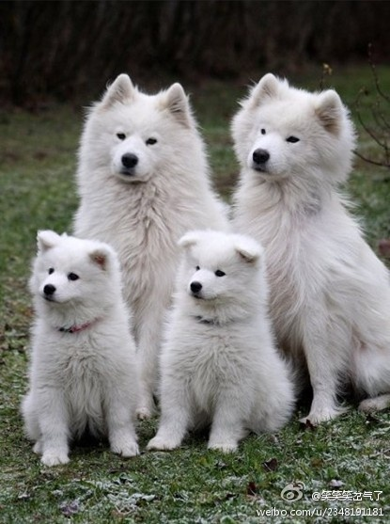
Inherited Traits

Slide 5
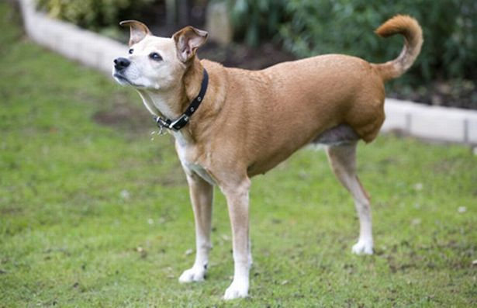
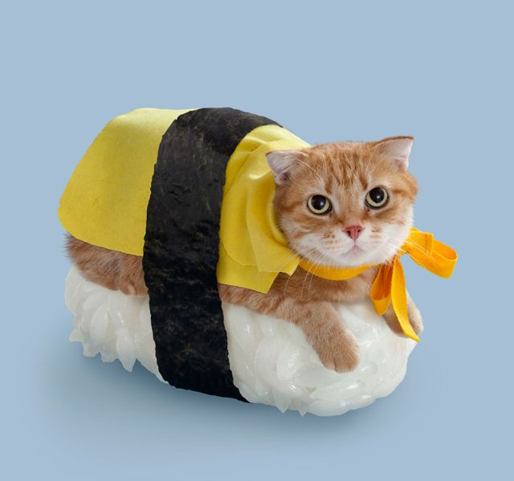
Acquired Traits

Slide 6
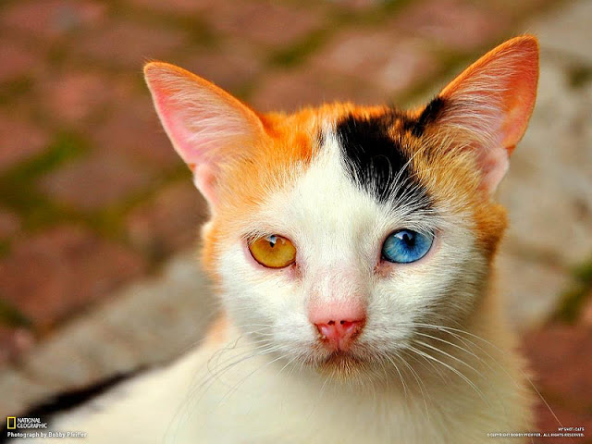
Mutations

Slide 7
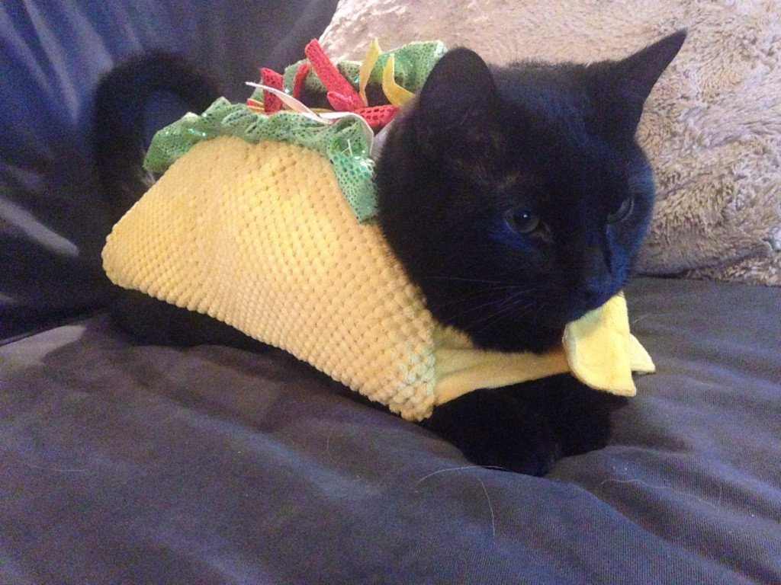
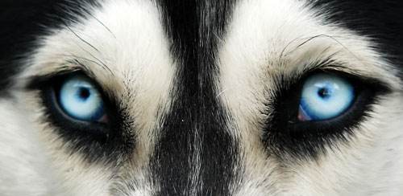
Physical Traits: Inherited or Acquired?
This dog has blue eyes.
This cat looks like a taco.

Slide 8
Physical Traits: Inherited or Acquired?
This dog has blue eyes.
This cat looks like a taco.
INHERITED!
ACQUIRED!

Slide 9
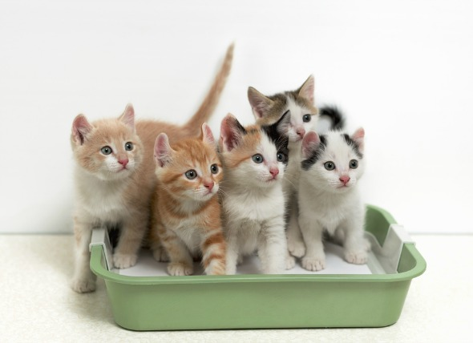
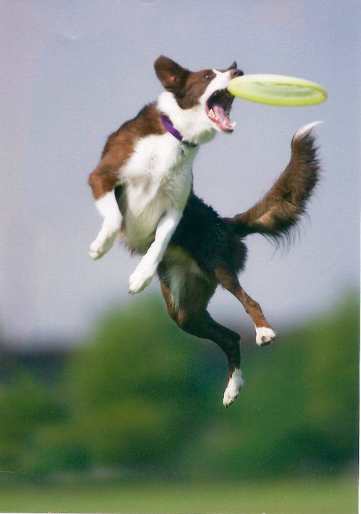
Behavioural Traits: Inherited or Acquired?
This dog can catch a frisbee.
Cats use a litter box.

Slide 10
Behavioural Traits: Inherited or Acquired?
This dog can catch a frisbee.
Cats use a litter box.
INHERITED!
ACQUIRED!

Slide 11
QUIZ!
Is the trait
INHERITED or ACQUIRED?
And is it
PHYSICAL or BEHAVIORAL?

Slide 12
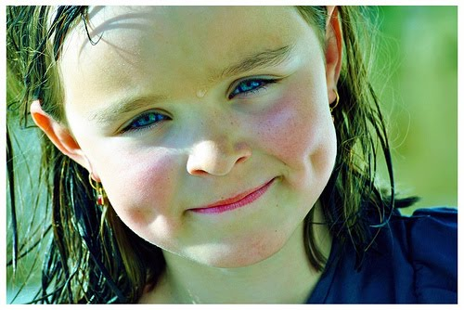
#1. This kid has dimples!

Slide 13
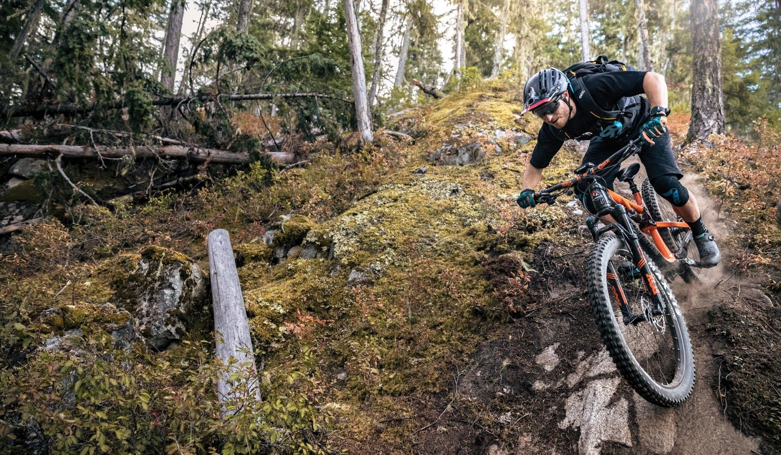
#2. Tim is good at biking.

Slide 14
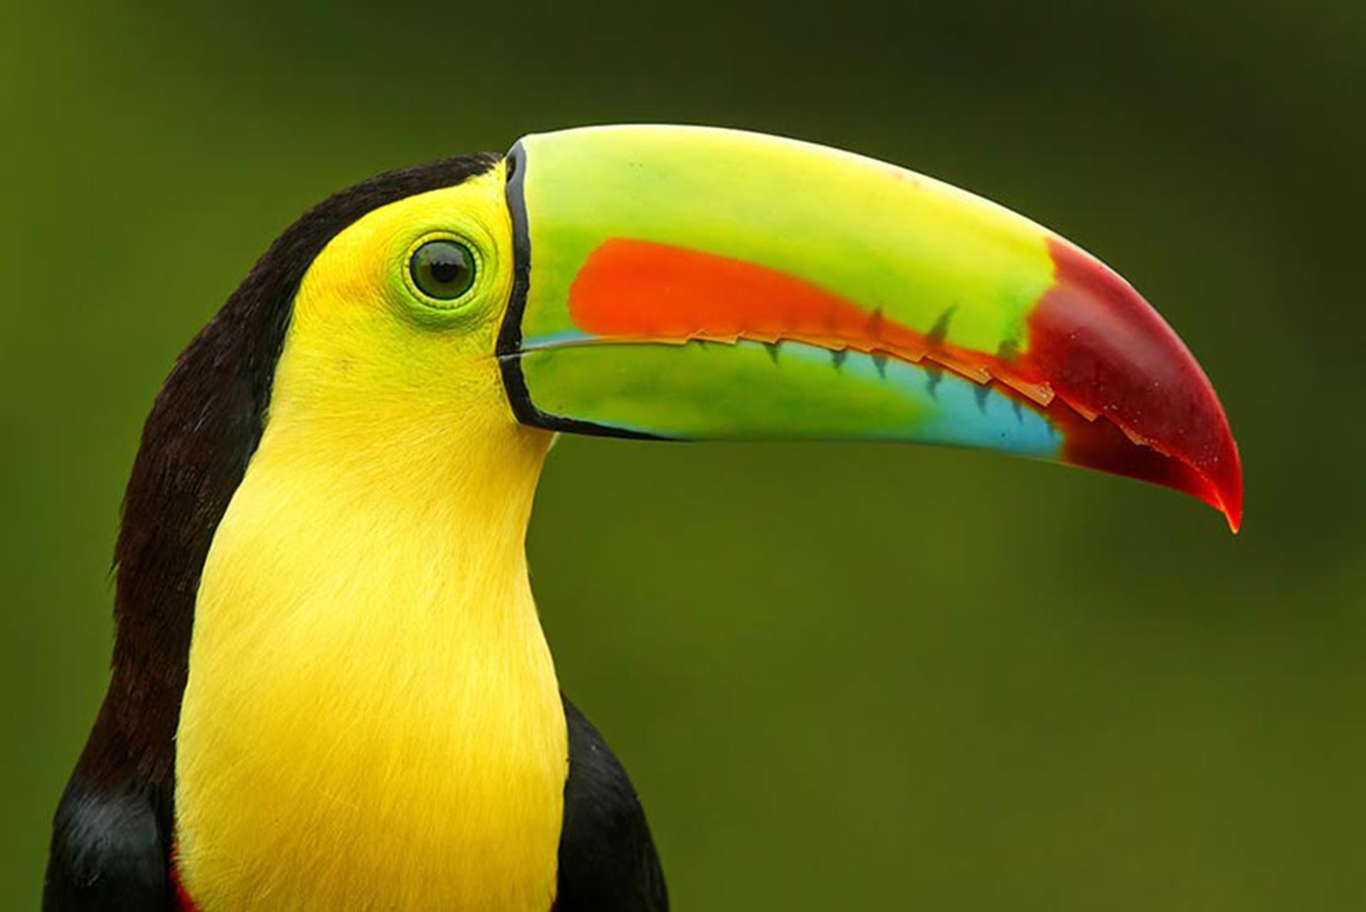
#3. Toucan’s have colorful beaks.

Slide 15
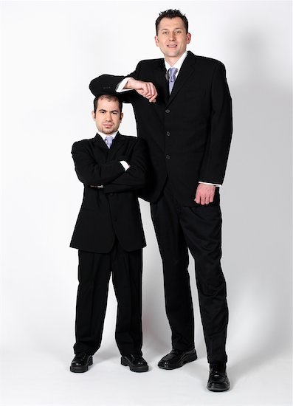
#4. Jerry is short.

Slide 16
#5. Jess can speak a bunch of languages.

Slide 17
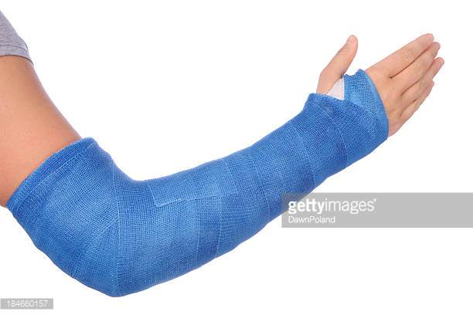
#6. Kerry broke an arm.

Slide 18
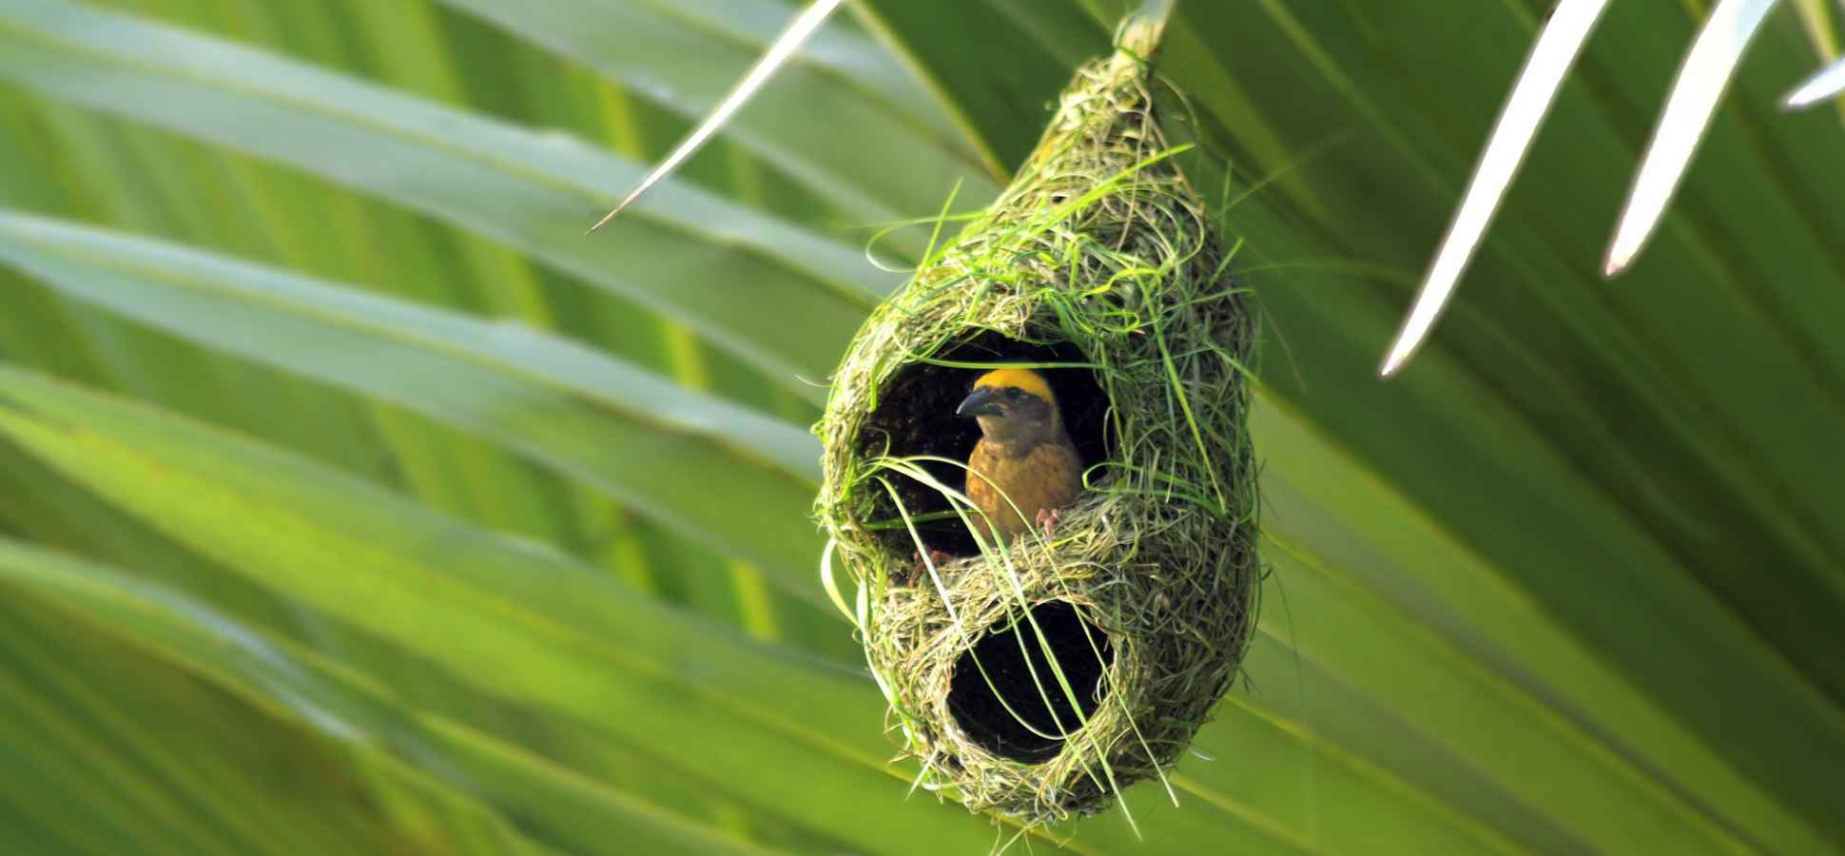
#7. Birds make nests and incubate eggs.

Slide 19
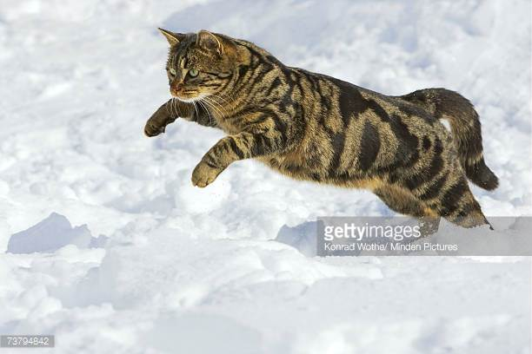
#8. Cats pounce when hunting.

Slide 20
#9. Dwayne has good muscle tone.

Slide 21
#10. Anika falls asleep in class.

